Slide 1

Airline Analysis
ANALYTICS AND PREDICTIVE INSIGHTS
Chung-Kai Chou

Slide 2
Statement
This project aims to use the airline review data to create a visual analytics and develop predictive models. The visualization will enable company to understand airline performance metrics and trends, while the model will predict customer satisfaction and sentiments, and thus to get potential business outcome or early waring by using machine learning and natural language processing techniques.
Research Questions
1. What are the key performance indicators or factors for airlines based on the review?
2. Can the satisfaction be predicted?
3. How do airline company leverage insights from data to improve service and operational efficiency.
4. What value can review content brings if the satisfaction and rating already there?

Slide 3
PROCESS/ STEPS
Web scraping
Data Cleaning
Exploratory Data Analysis
Tradition Vectorizer with Machine Learning
RNN/LSTM/Bidirectional RNN/ Transformer
GPT2 Classification

Slide 4




WEB SCRPAING
Get Airline Names
Get Pages
Get Infomation
Result
Get all the Airline company’s name from A-Z list
Get the total page number for each Airline company and form them as dictionary for easier lookup and iteration
Scrapping all useful information from the review block
Scraped total 131906 rows of data with 19 features

Slide 5
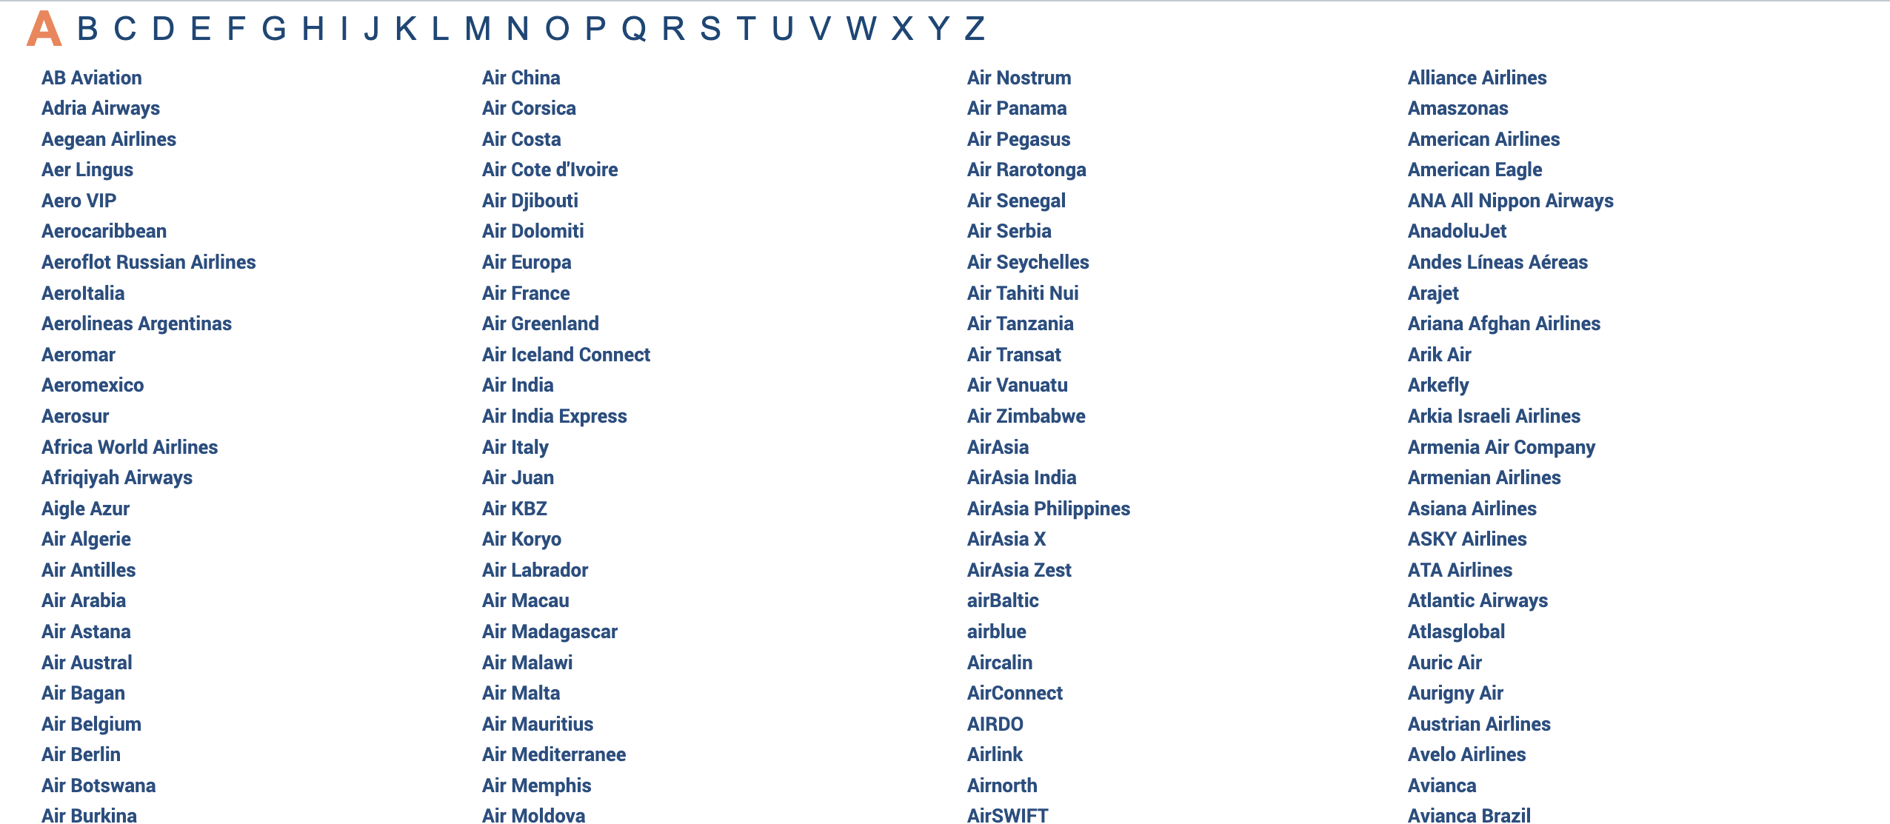
WEB SCRPAING

Slide 6

DATA CLEANING
Reviewing Scraping format
Dropping unwanted feature
Feature Extraction and Combination
Reorganizing departure and arrival name
Dropped Aircraft feature for having data inconsistency and much missing data
extract a new feature from the content and set it as trip_verified
Combining the title feature with the content feature
extract three new features departure, arrival, and Flight_type from Route
Extract two new features, Month and Year from Date Flown
use Fuzzywuzzy package to standardize the city name.

Slide 7
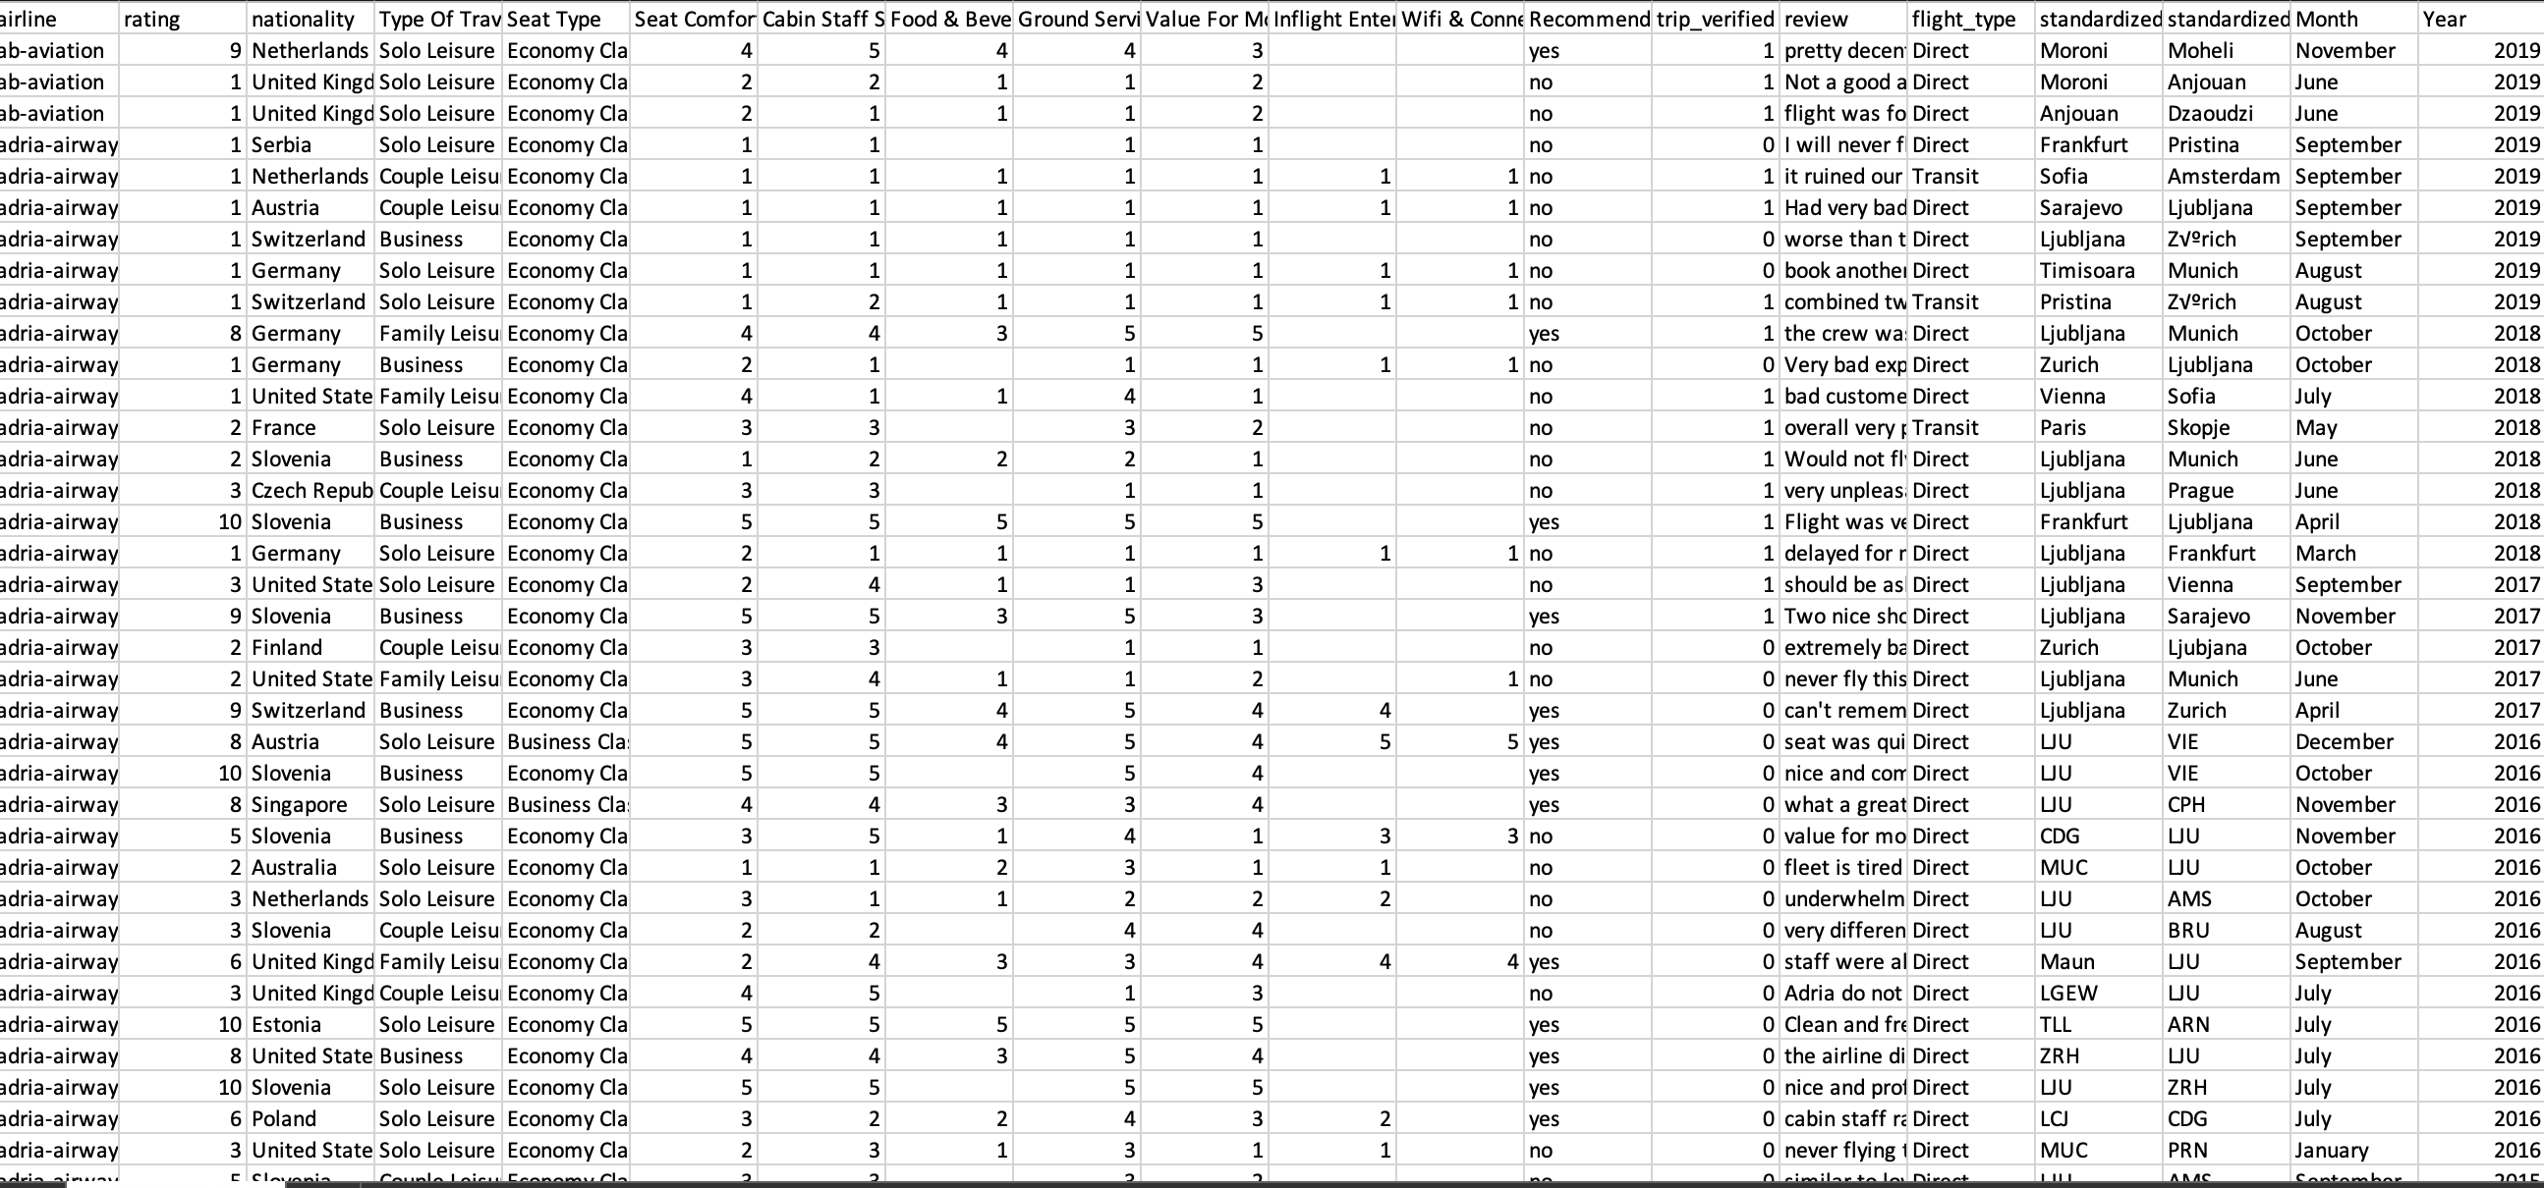
DATA CLEANING

Slide 8
EXPLORATORY DATA ANALYSIS
Exploratory Data Analysis (EDA) was crucial in identifying key performance indicators from airline reviews, such as service quality and seating comfort. Visualizations and word clouds facilitated the discovery of trends and customer sentiments, guiding subsequent predictive modeling efforts.

Slide 9
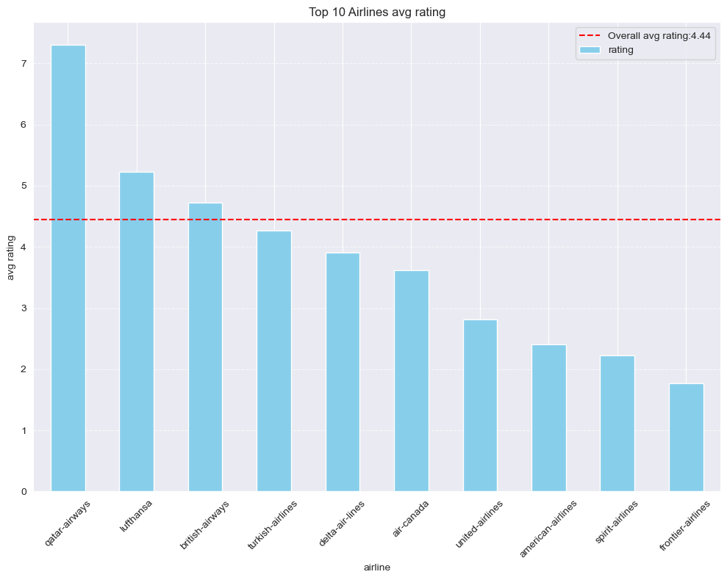
EXPLORATORY DATA ANALYSIS
The analysis reveals that Qatar Airways outperforms other major airlines in ratings, while low-cost carriers like Spirit and Frontier have lower ratings.
This disparity is attributed to the higher ticket prices and perceived value associated with Qatar Airways compared to budget airlines.

Slide 10
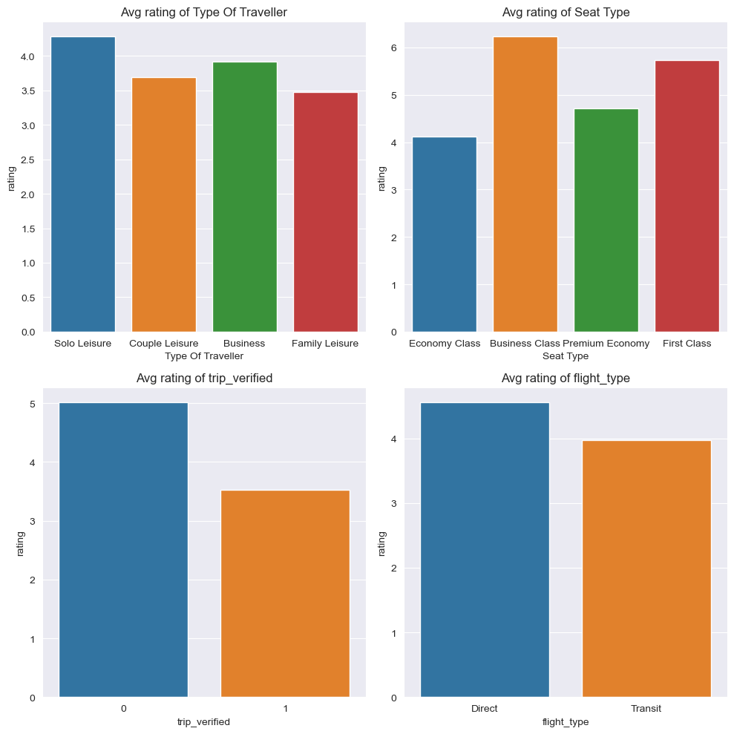
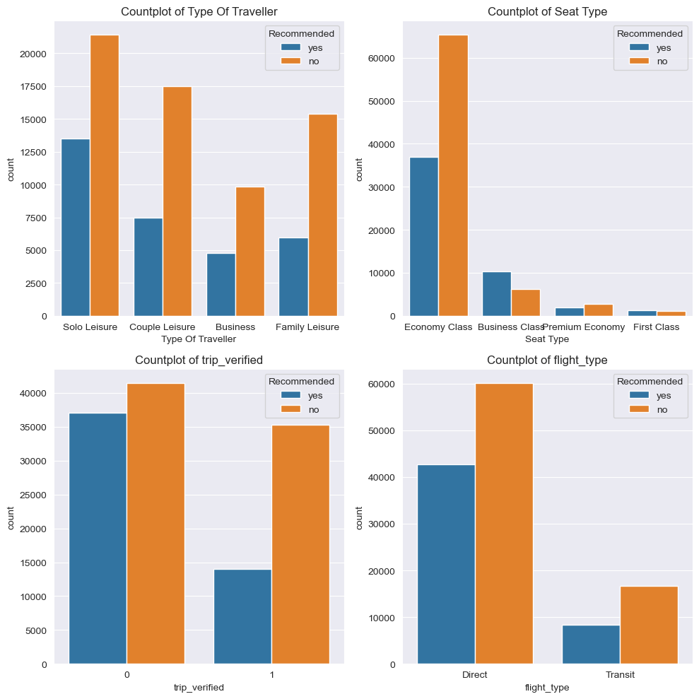
EXPLORATORY DATA ANALYSIS

Slide 11
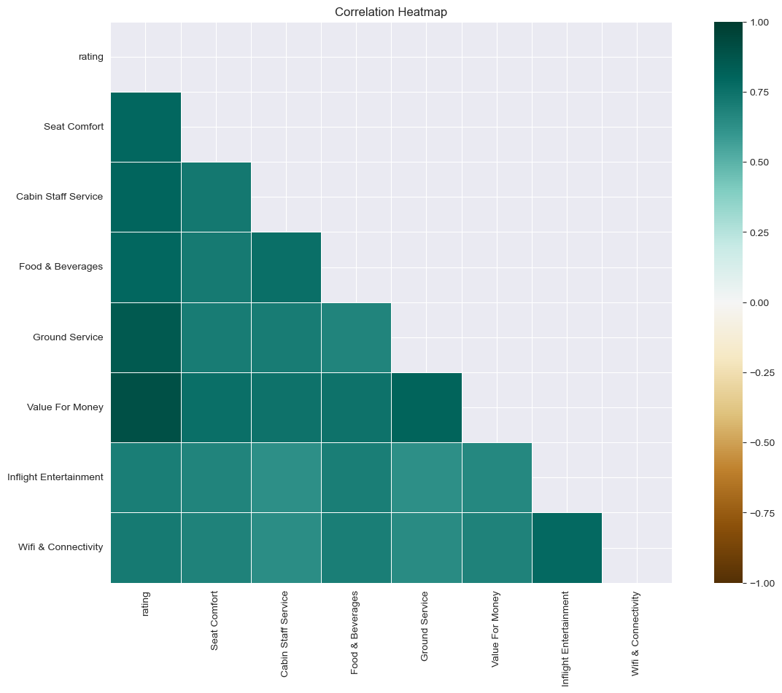
EXPLORATORY DATA ANALYSIS
The heatmap indicates strong positive correlations between ratings and factors such as Value for Money, Ground and Cabin Staff service, and Seat comfort. These insights suggest potential areas for airlines to enhance to potentially improve their ratings. Note, however, that correlation does not imply causation.

Slide 12
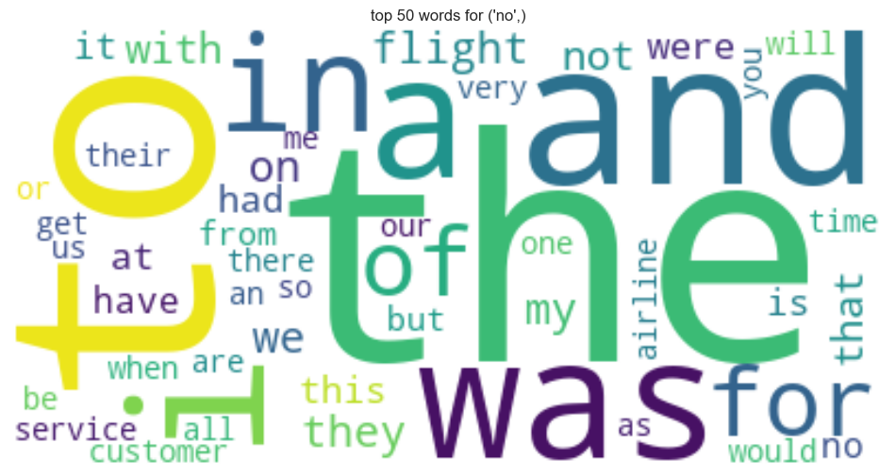
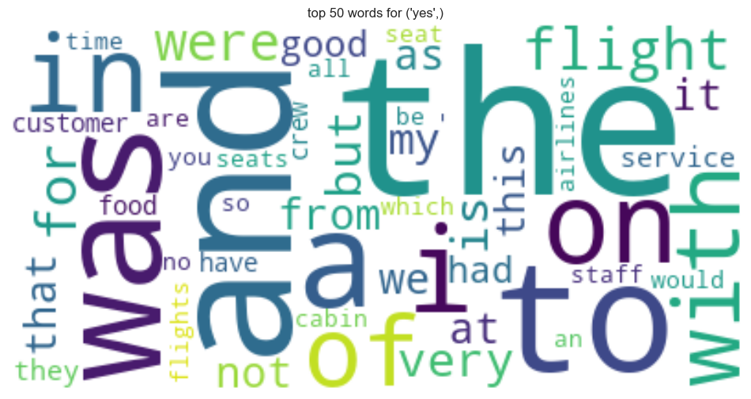
EXPLORATORY DATA ANALYSIS- WORD CLOUD
Before Preprocessing
Review From Customer Doesn’t Recommend
Review From Customer Recommend

Slide 13
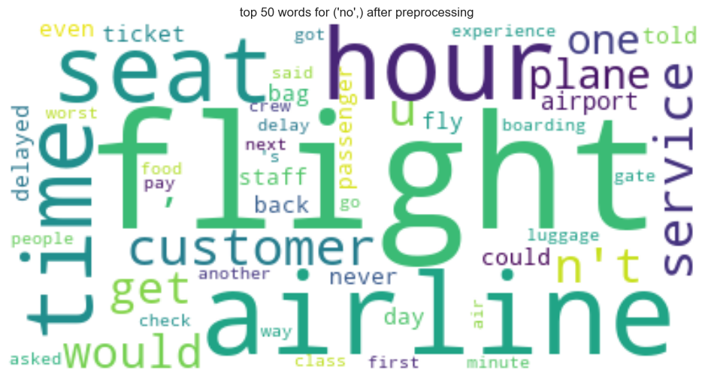
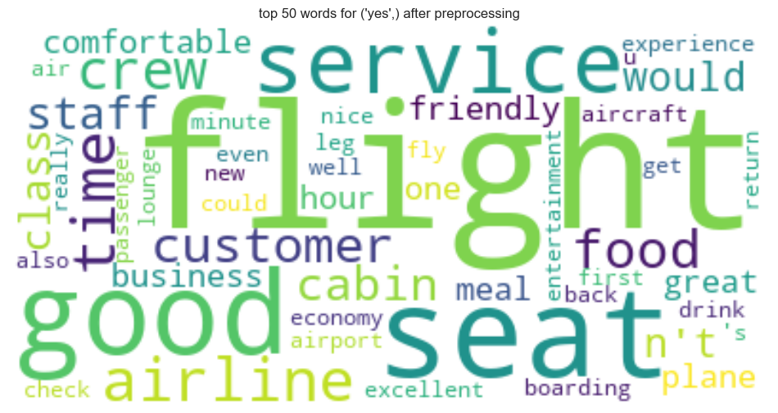
EXPLORATORY DATA ANALYSIS- WORD CLOUD
After Preprocessing
Review From Customer Doesn’t Recommend
Review From Customer Recommend

Slide 14
VECTORIZER WITH MACHINE LEARNING
Employing two different vectorization techniques alongside three machine learning algorithms to predict flight recommendations from customer reviews.
This approach allows us to capture nuanced textual features essential for accurate predictions, thereby enabling us to enhance the flight experience with targeted insights

Slide 15
VECTORIZERS / ALGORITHMS
Vectorizer
Algorithms
TF-IDF Vectorizer
Count Vectorizer
Union TF-IDF with Count
Naive Bayes
Logistic Regression
Random Forest

Slide 16
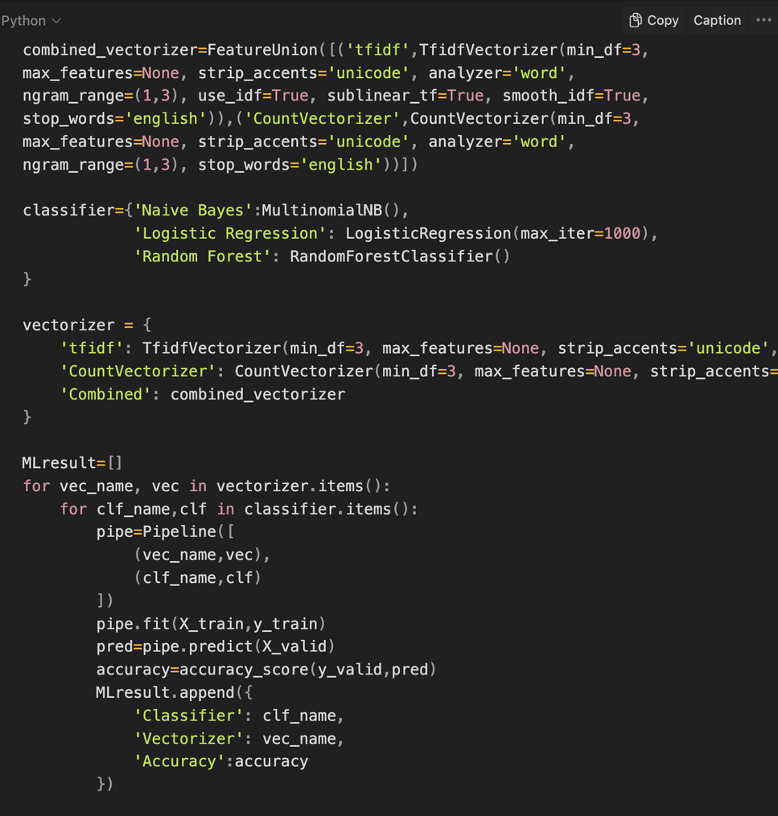
VECTORIZER/ML WROKFLOW
Loop over vectorizers
Loop over classifiers
Create Pipeline
Fit Pipeline on Training Data
Predict on Validation Data
Calculate Accuracy
Store Classifier, Vectorizer, and Accuracy
Move to the next classifier
Move to next vectorizer

Slide 17
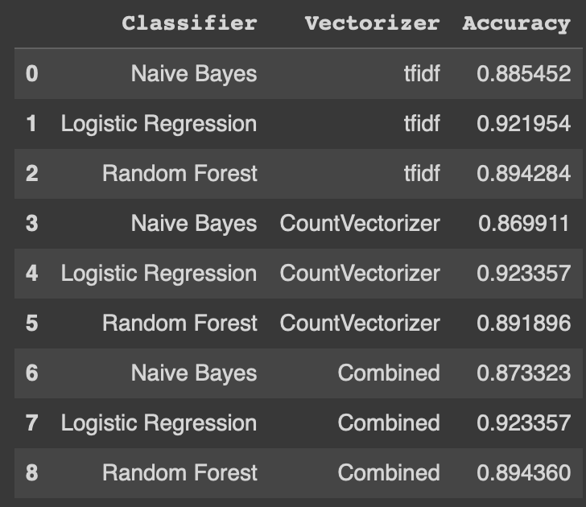

VECTORIZER/ML RESULT

Slide 18
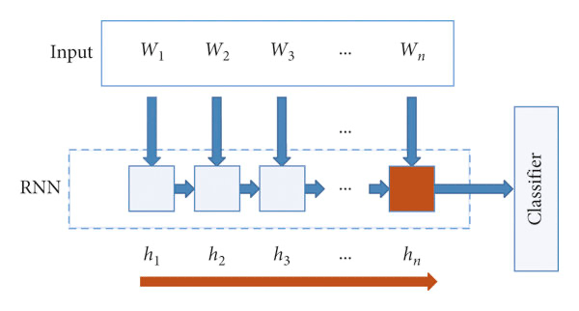
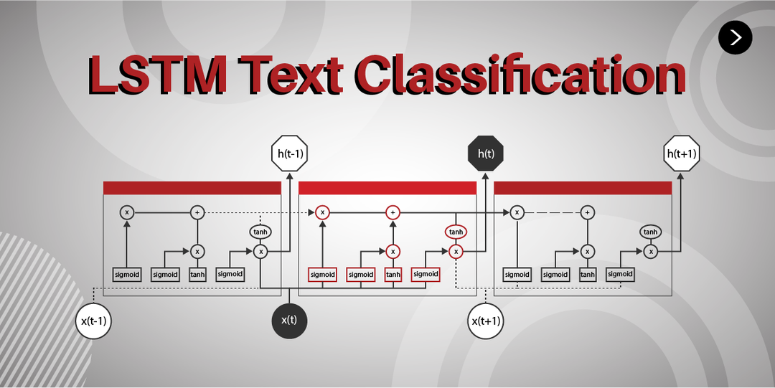
RNN/LSTM/B-RNN/TRANSFORMER
RNN
LSTM

Slide 19
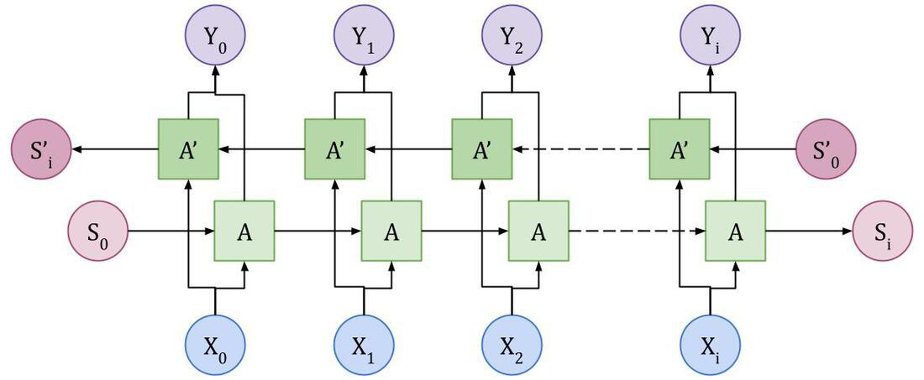

RNN/LSTM/B-RNN/TRANSFORMER
Bidirectional RNN
Transformer

Slide 20
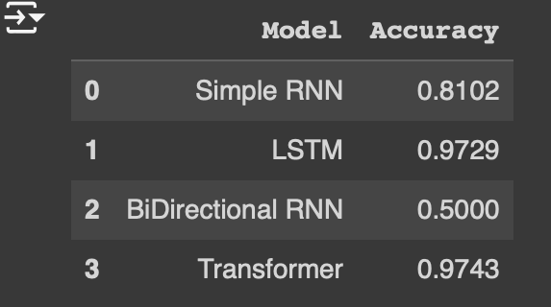

RNN/LSTM/B-RNN/TRANSFORMER-RESULT

Slide 21
GPT2 CLASSIFCATION
Integrated the GPT-2 model with the Hugging Face Transformers library to classify airline reviews. This advanced NLP approach allowed us to leverage the generative capabilities of GPT-2, tailoring it to predict customer satisfaction based on textual feedback, despite computational constraints limiting the scope of data processed.

Slide 22
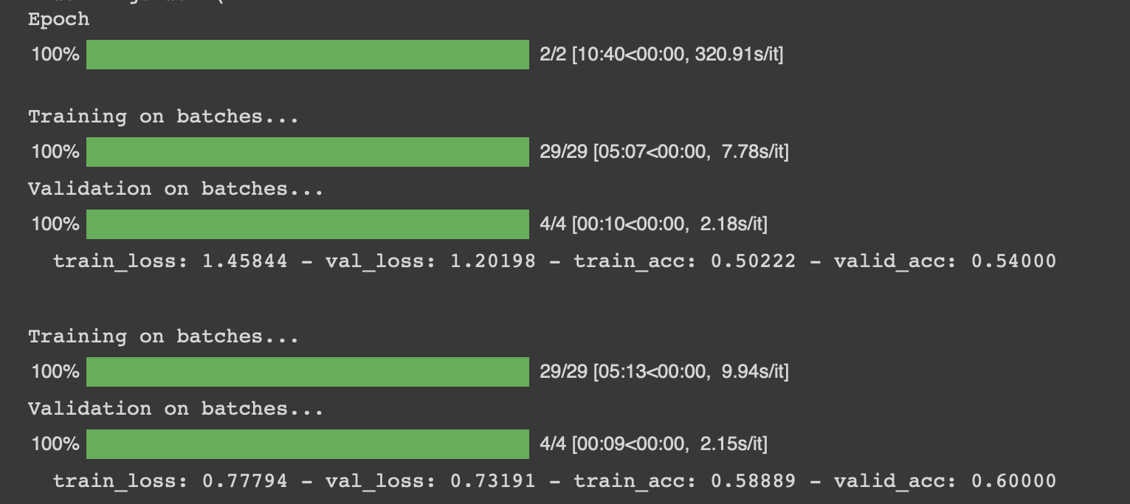
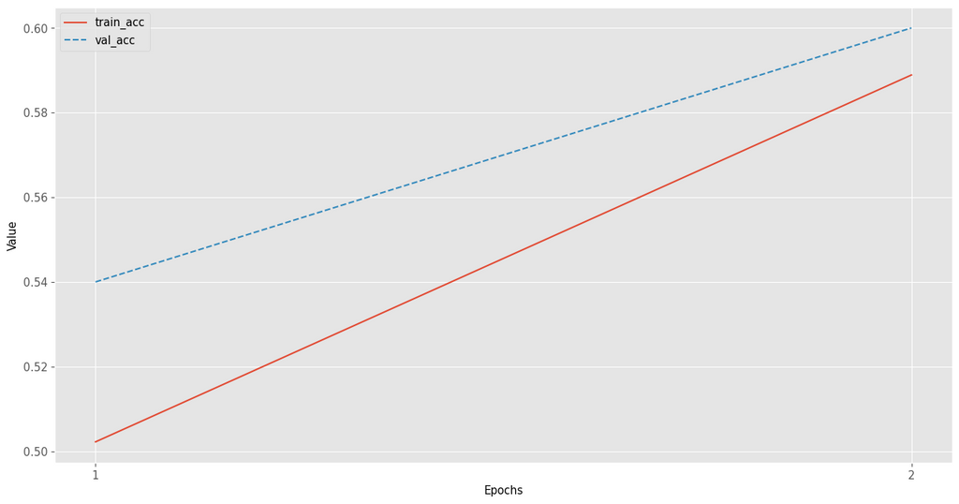
GPT2 CLASSIFICATION WORKFLOW WITH RESULT
Environment Setup
Load GPT-2 Model
Data Preparation
Tokenization
Dataset Creation
Modify Model for Classification
Training
Fine-tuning
Backpropagation
Evaluation

Slide 23
FINAL WRAP-UP
This report identifies factors affecting customer satisfaction, such as service quality and staff behavior, using machine learning to predict flight recommendations.
These insights help airlines improve service and operations, bridging qualitative feedback with quantitative ratings for targeted enhancements.

Slide 24
Thank you!

